Slide 1

Alexis Covington, Nikhil Nayak, Kurt Spencer, Abhinav Srinivasan, Neha Vinod Ahir

Slide 2
Features
Sign in through Google+
Creating a bucket
Exploring the map
Rating and reviewing a place
Sharing a bucket
Top buckets listing

Slide 3

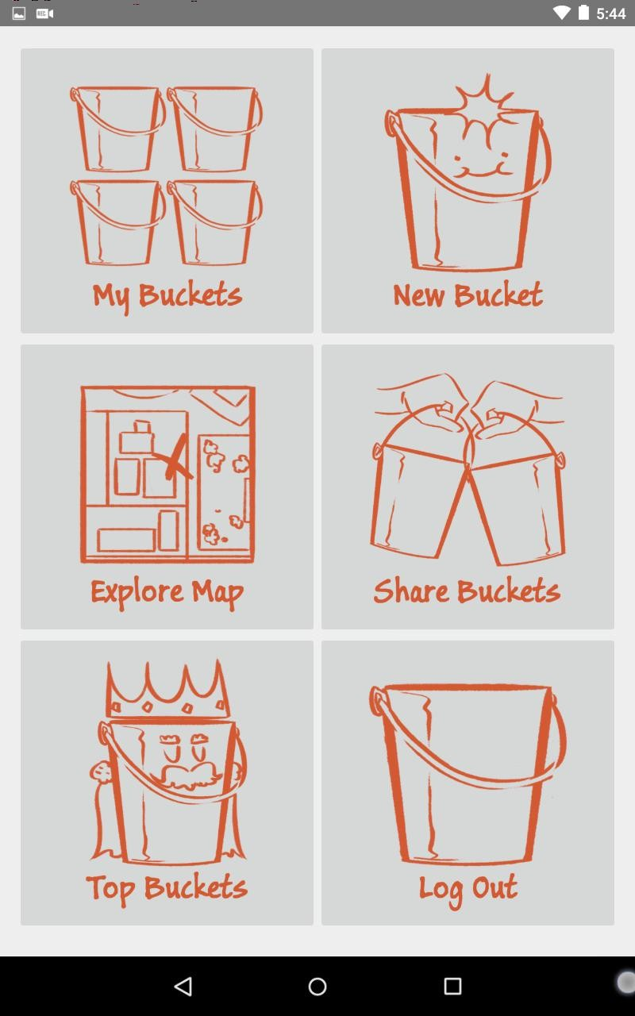
Google+ sign in
App home page

Slide 4
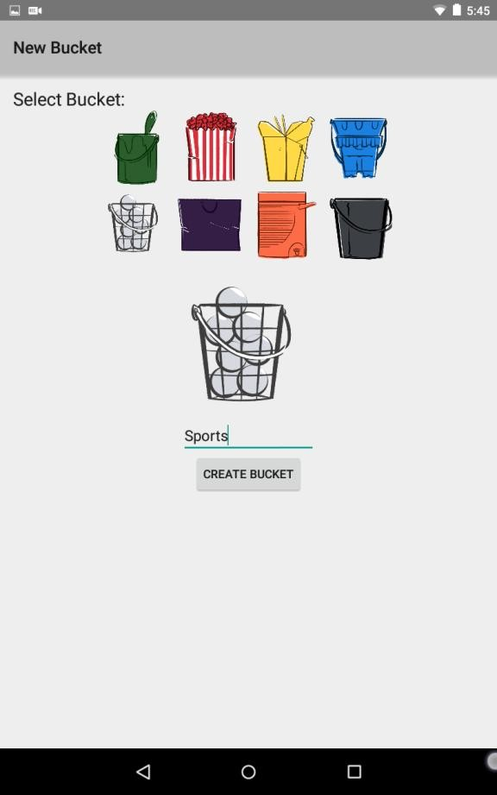
New Bucket
User selects a bucket image, names the bucket whatever he/she wants, then creates the bucket by tapping create

Slide 5
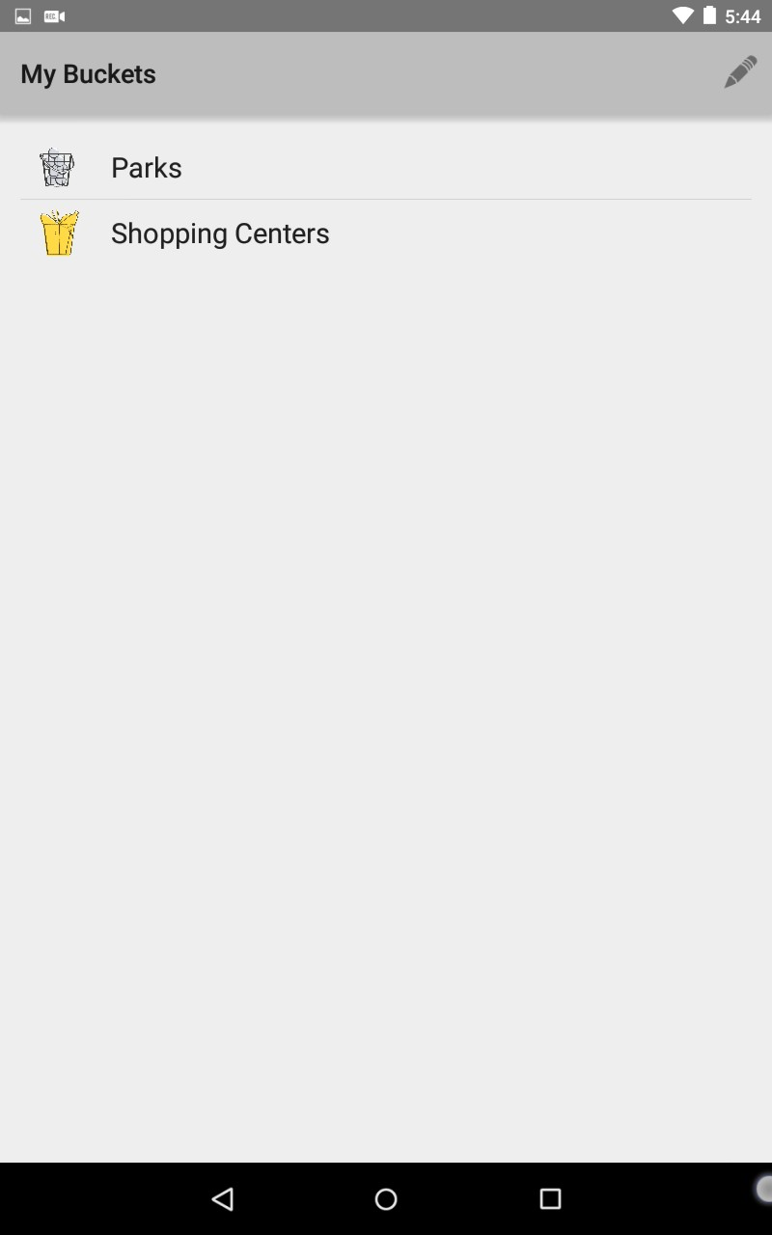
My Buckets
Shows the name and image of each bucket created by the user
User can edit the bucket name or delete a bucket

Slide 6
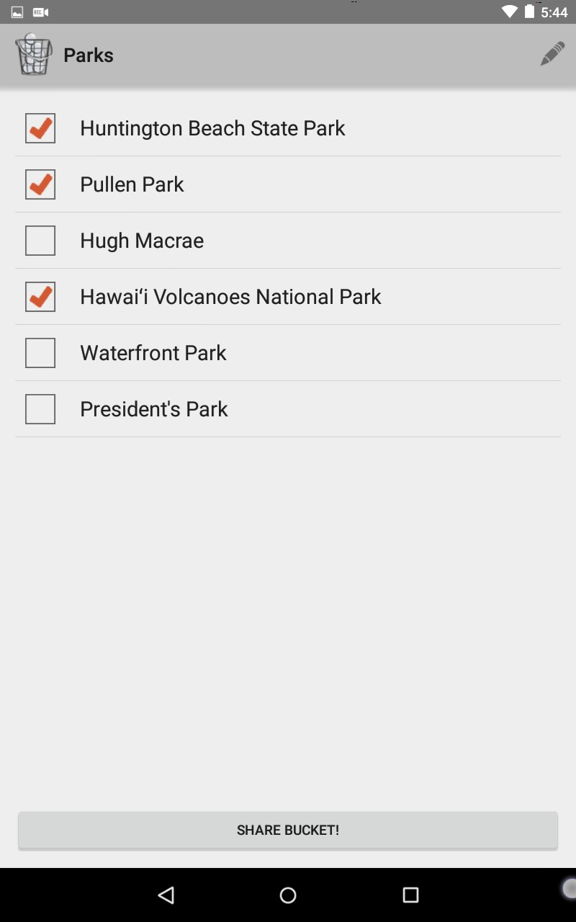
Inside a Bucket
Displays the name of each place added to a bucket
Can edit place names, delete places, and mark places as visited
Click on a place to view place information page
Share entire list of places using Google+

Slide 7
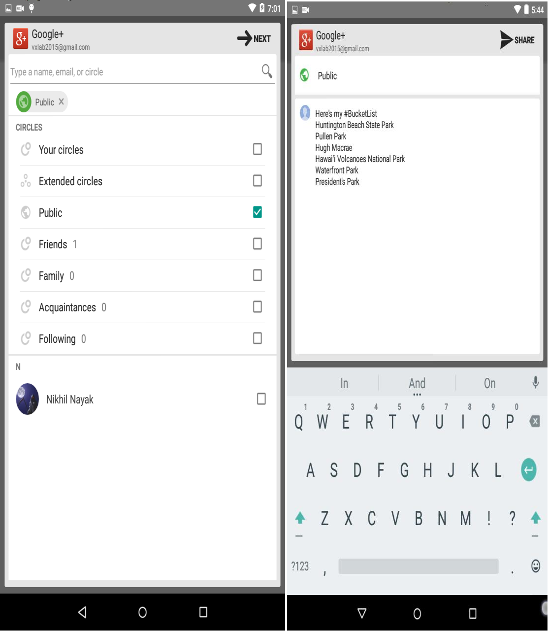
Sharing
a bucket

Slide 8
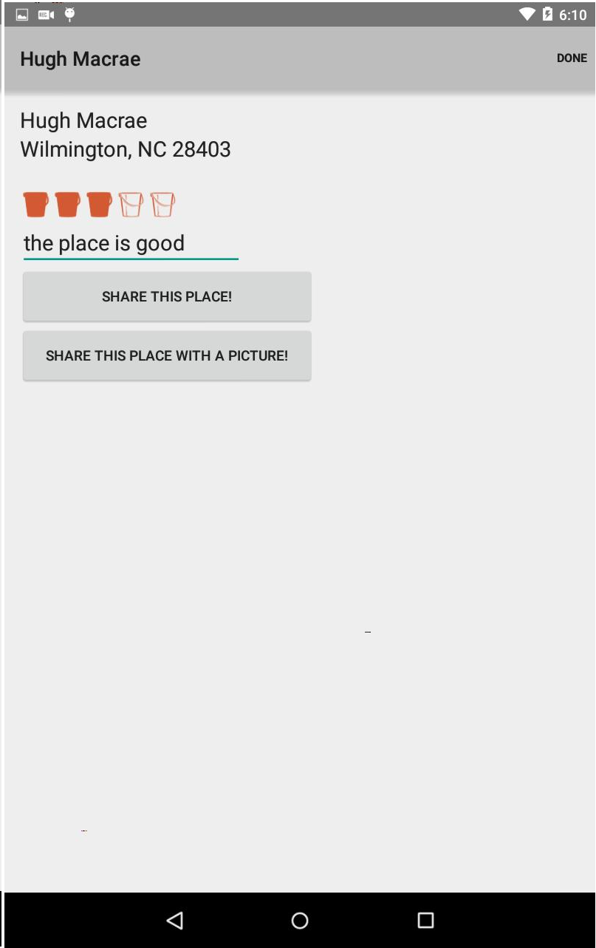
Place Information Page
Address information of the place displayed
User can assign a rating to the place and leave a review
User can share the place using Google+ (with or without a picture upload)

Slide 9
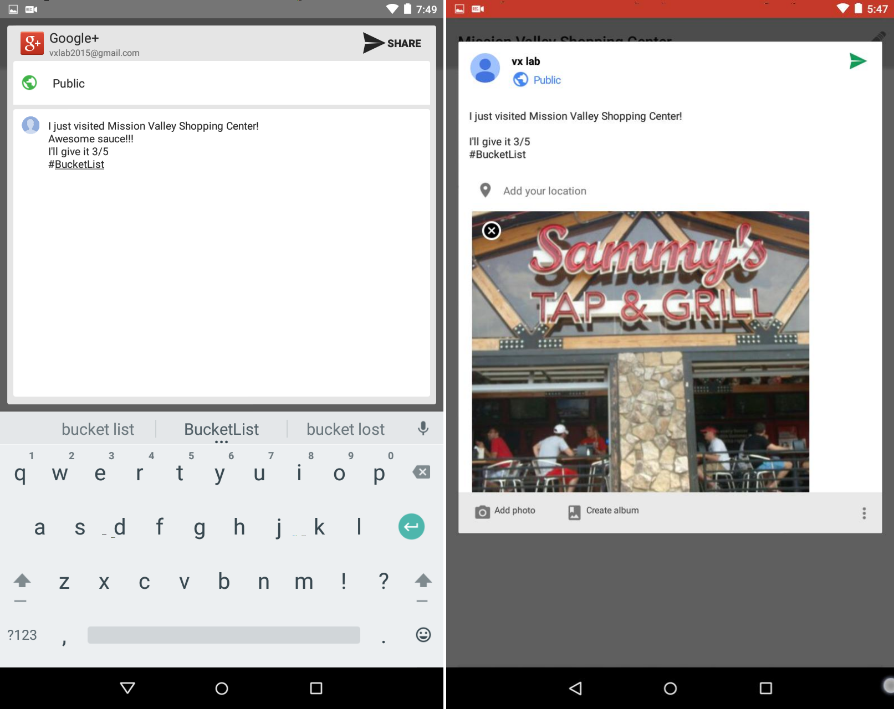
Sharing
a place

Slide 10
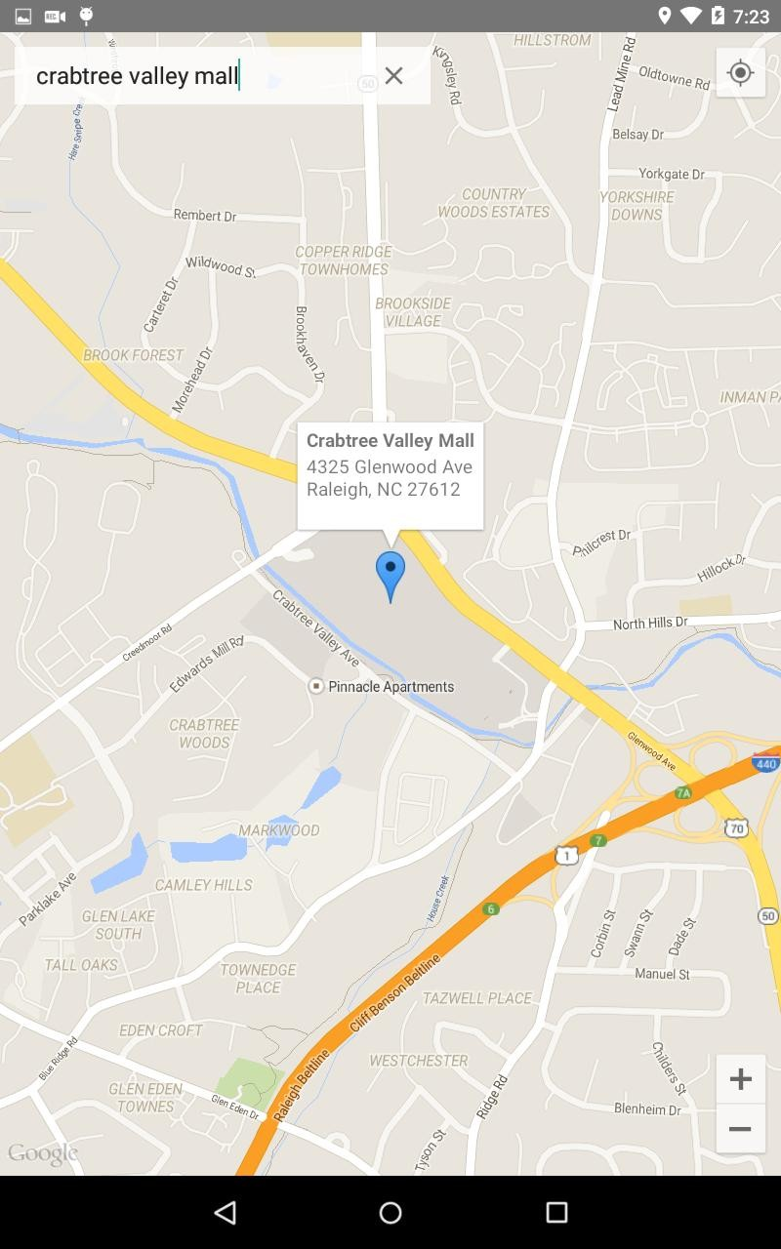
Explore Map
Two ways to add markers to the map:
Search for a place using the search bar
Long press on a location on the map
Tap the marker to see info window (toggles)
Long press on marker to add place to a bucket
Cancel adding place through cancel button or long pressing again
Marker changes to bucket image after added to bucket (see next slide)
Find my location button and zoom buttons available

Slide 11
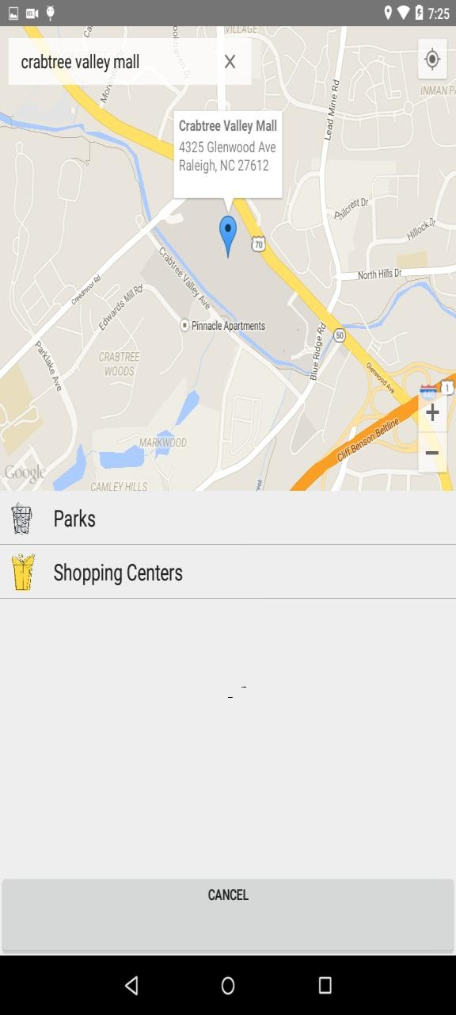
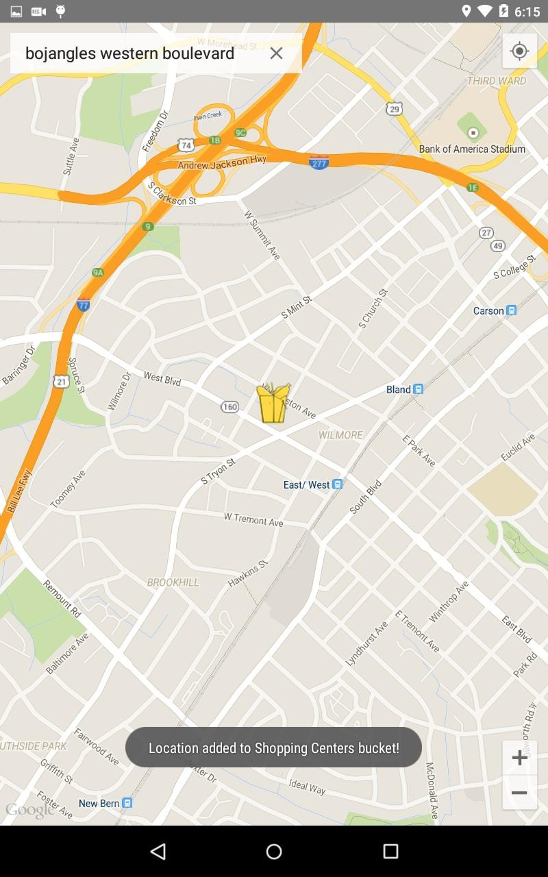
Adding to a bucket

Slide 12
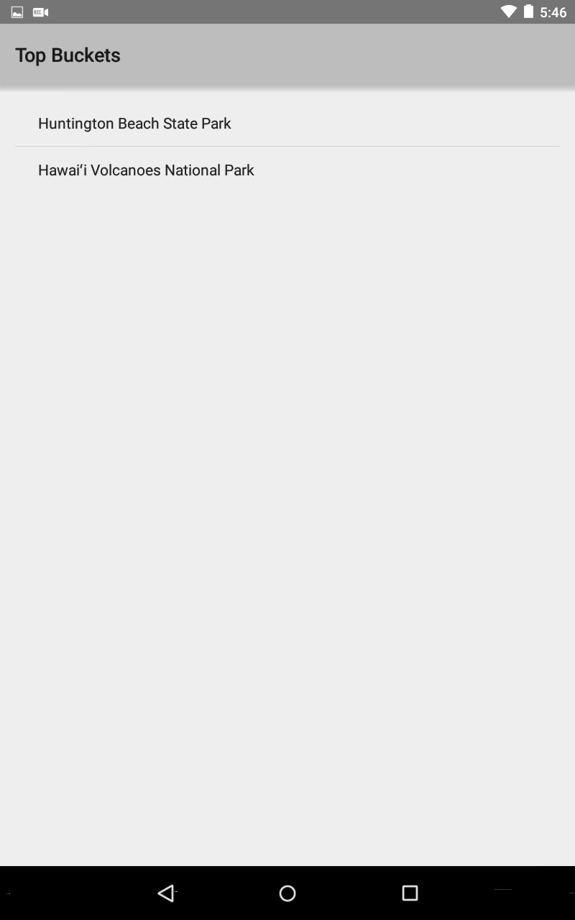
Top Buckets
Displays any place the user rated as 5 buckets (the highest rating)
Can view place information page by clicking on the place here as well

Slide 13
Technology Stack
Android OS
Google+ for authentication and sharing
Google Maps API
SQLite for database

Slide 14
User Evaluation Results
App icon should be changed as it doesn’t stand out
Share Buckets button on home page is misleading since you actually need to go into a bucket to share it with our current implementation
Difficult to figure out that long click is how you add a place to a bucket without a tutorial
Place information page has a lot of free space when viewed on tablet (needs improvement)

Slide 15
Future Work
Add auto-complete to location search
Add Facebook login in addition to the existing Google+ login
Allow user to share buckets with each other directly through the app and show buckets that have been shared with the user in Share Buckets
Integrate Places API to get more information about a place (such as other Google user’s ratings of the place)
Add in community reviews of a place
Allow users to further customize buckets (change colors, overlay stars etc.)
Add pictures of places to the place information page
Improve UI in general

Slide 16
Thanks
Meg Snyder and Kelly Fish for the lovely bucket images!!

